Slide 1

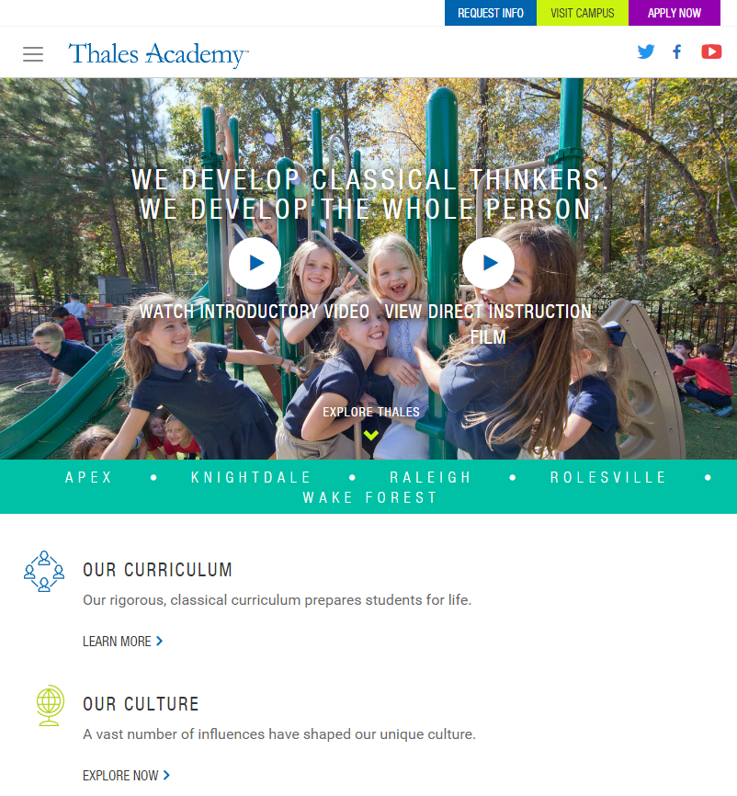
Thales Academy
Business Need
Thales Academy is an affordable private school in the Southeast that focuses on integrating technology with classic teaching models. Thales came to Affirma when they wanted to refresh their existing website with a modern, clean design.
In addition to updating the look and feel of the site, Thales was looking to implement a marketing tool to increase enrollment. The school had no trouble converting potential students who made it to a campus visit, but it did face frustrations converting site visitors
What We Did
Affirma’s design team refreshed the look and feel of the site’s front-end in order to provide a streamlined, user-friendly experience.
We developed a 100% responsive design that would be consistent across all browsers, operating systems, and devices.
We created a design that directed site viewers towards a marketing tool that allowed them to easily sign up for a campus visit.
Results
The client was very satisfied with the resulting website and their marketing team was thoroughly impressed with the look and feel of the site.

